Slide 1




Git Going: Launching Your Code Journey with GitHub & Visual Studio Code
Joe Gasper
Systems Administrator
University of Florida
Institute of Food and Agricultural Sciences
gasperj@ufl.edu
in/joegasper
@joegasper & @gasperj
Notes:
Goal is to get comfortable working with code.
C#, JavaScript, Markdown, PowerShell, Python, R, XML, YAML…
in a modern, professional process and tooling.
Don’t let me get you lost, ask questions, stop me.

Slide 2

Session Overview
Workshop Session
Hands-on experience
Covering
Why, what, how
Practical Approach
JET – Just Enough Tools
Notes:
Please follow along, get out your laptops.
Why this is important to you and your people, your faculty & educators.
The tools we are going to use.
Just the basics, Minimally Viable Process
GitHub and VS Code Explanation
Setting Up the Development Environment
Git Installation Instructions
VS Code Installation Guide
GitHub Account Creation Process
Configuring VS Code with GitHub Integration
GitHub Sign-in in VS Code
Initializing a New GitHub Profile Repository
Cloning Repository to Local Machine
Creating and Managing a New Repository
Creating an Org and a Team and inviting members

Slide 3



GitHub and Visual Studio Code Explained (& Git, too)
Git: Distributed Version Control System
Serves as the foundational framework for code collaboration
Commit often, commit early – track every change
GitHub: Web-Based Version Control Platform
A repository hosting service for collaborative software projects
Facilitates version control and issue tracking
VS Code: Source Code Editor
Designed for writing and editing source code efficiently
Supports modern software development practices
Notes:
Today, we're discussing mainly two pivotal tools in software development: GitHub, the web-based version control hub, and VS Code, the versatile source code editor. Both play a crucial role in streamlining collaboration and coding practices.
But we need to start with the foundation on Git.
Git is not a protocol or API, but system or framework for version control – with distributed being the key.
Distributed is key – all devs have a full copy of the database (the code) and can work offline/disconnected.
Authored in 2005 by Linus Torvalds (LEE-nəs TOR-vawldz), creator of Linux.
Working in an analogy, think of Git as the construction and zoning regulations for a large city.
GitHub is a web-hosted developer platform that uses Git, and has additional features like access control, bug tracking, and more.
GitHub is the city and the land for a megapolis.
VS Code is a source code editor application, viewer, debugger.
Understands Git & most popular dev platform.
Cross-platform and extensible, and 9 years old
“Hidden” Git integration makes it special to me. Have never worked with or heard of Git before?
Wonder about push, pull, merge, fork, branch, rebase? Don’t worry with VS Code.

Slide 4

Why GitHub?
Version Control
Collaboration
Community
Open Source
Project Management
Issue Tracking and Documentation
Never Lose Code
Yours or Others
Grow and Show
Demonstrate Skills
Notes:
Version control – contrast to OneDrive and Excel/Word track changes
Central management of DISTRIBUTED version control, RBAC, code reviews
Community:
GitHub is the largest source code host,
100 million users
420 million repositories (28m public)
PM – do more than code – ticket system, wiki, web host
Faculty love side projects with students – ever get the source code?
Show your work, your work shows your skills

Slide 5

Why VS Code?
Fast and Lightweight
Small, simple yet powerful cross-platform editor
Rich Language Support
100s of languages
Built-in Git and Terminal
Version control without leaving the editor
Customizable and Extensible
Themes, font size, key bindings and extensions!
Notes:
Quick install, via winget, chocolately, MS Store, zip
Syntax highlighting, auto-completion, variable inspection, debugging.
C# to YAML
VS Code makes Git easy. Terminal built-in makes it easy to test your code.
ISE Theme – feels like home
Thousands of extensions
Major vendors: AWS to Google to Red Hat. Cobol for IBM mainframes!

Slide 6
Source Control Operations Defined
Repository (Repo) Where your projects are stored – on your computer or online.
Commit An individual change to a file or files. A unique ID records who, when, and what changed.
Clone A copy of a repo on your computer, or the act of making a copy.
Push Sending your committed changes to the remote repo.
Pull Getting and merging changes from the online repo to your local clone.
VS Code Sync Performs a push to and then a pull from the remote repo.
Notes:
For what We don’t need to get complicated with branches, merging, forking, and rebasing,
Repo: A directory or storage space where your projects can live. It can be local to a folder on your computer, or it can be a storage space on GitHub or another online host.
Commit: An individual change to a file (or set of files). It’s like when you save a file, except with Git, every time you save it creates a unique ID (a.k.a. the “commit hash”) that allows you to keep record of what changes were made when and by who.
Clone: A copy of a repository that lives on your computer instead of on a website’s server somewhere, or the act of making that copy.
Pull: Refers to when you are fetching in changes and merging them. For instance, if someone has made changes to the remote repository, you would pull those changes to your local repository.
Push: This is the action of sending your committed changes to a remote repository on GitHub.com.
VS Code Sync: This action in VS Code will perform a push and then a pull commits to and from the remote repository.

Slide 7
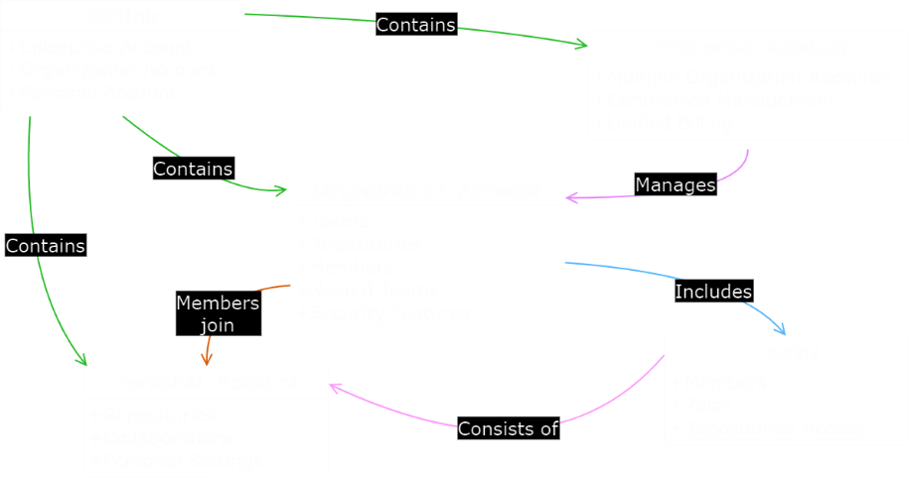
GitHub Account Architecture: Org

Slide 8
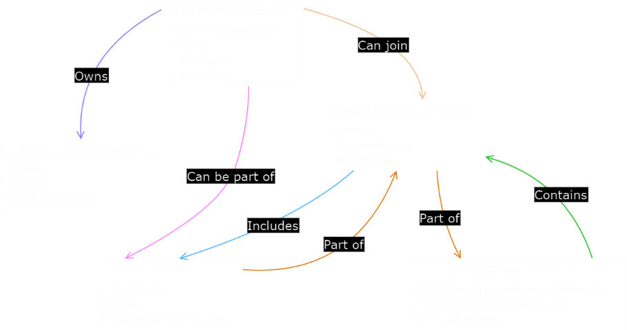
GitHub Account Architecture: User

Slide 9

Development Environment Overview
Downloading
and
Installing
Git
Downloading
and
Installing
VS Code
Creating
a
GitHub
Account
Notes:
Today, we'll be setting up our development environment in about 10 minutes.
We'll start by downloading and installing Git,
then download and install Visual Studio Code,
and finally, we'll move on to creating a GitHub account.

Slide 10


Development Tools: Git
https://git-scm.com/downloads
Exe install – take the defaults
PS> winget install Git.Git
$ brew install git
# sudo apt install git
{ git.path = "C:\Git\bin\git.exe" }
Downloading
and
Installing
Git
Demo⌚
Notes:
Installing winget in Sandbox
$progressPreference = 'silentlyContinue'
Write-Information "Downloading WinGet and its dependencies..."
Invoke-WebRequest -Uri https://aka.ms/getwinget -OutFile Microsoft.DesktopAppInstaller_8wekyb3d8bbwe.msixbundle
Invoke-WebRequest -Uri https://aka.ms/Microsoft.VCLibs.x64.14.00.Desktop.appx -OutFile Microsoft.VCLibs.x64.14.00.Desktop.appx
Invoke-WebRequest -Uri https://github.com/microsoft/microsoft-ui-xaml/releases/download/v2.8.6/Microsoft.UI.Xaml.2.8.x64.appx -OutFile Microsoft.UI.Xaml.2.8.x64.appx
Add-AppxPackage Microsoft.VCLibs.x64.14.00.Desktop.appx
Add-AppxPackage Microsoft.UI.Xaml.2.8.x64.appx
Add-AppxPackage Microsoft.DesktopAppInstaller_8wekyb3d8bbwe.msixbundle

Slide 11

Development Tools: VS Code
https://code.visualstudio.com/download
Windows: Choose the “User Installer”
PS> winget install Microsoft.VisualStudioCode
$ brew install --cask visual-studio-code
# sudo snap install code --classic
Microsoft Store
Downloading
and
Installing
VS Code
Demo⌚
Notes:
You’ll encounter an “Insiders” version
https://www.linuxcapable.com/install-visual-studio-code-on-ubuntu-linux/

Slide 12
Development Tools: GitHub
https://github.com/
One Account to Rule Them All
Welcome to GitHub!
Let’s begin the adventure
Enter your email*
joegasper@gmail.com
Create a password*
**********************
Enter a username*
joegasper-gm
Creating
a
GitHub
Account
Continue
Notes:
One user account needed. Not your university’s email address.
2, only if your Enterprise uses an identity management service with GitHub.
Microsoft Azure/Entra ID with SCIM provisioning
System for Cross-domain Identity Management.
Talk about account joining Teams, Orgs, etc.
Put code in a repo in an org that reps you univ.
You created the code, credit for the code, but Org “owns”.

Slide 13
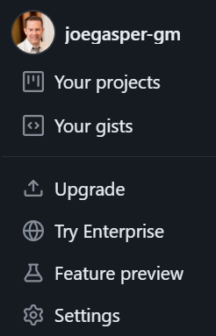
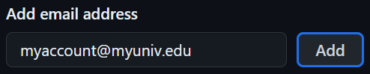
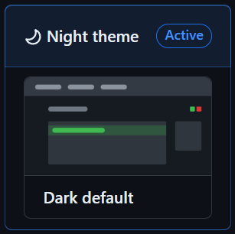

Development Tools: GitHub
Settings
in a
GitHub
Account
Notes:
Settings
Theme
Emails – verify univ
Password – 2FA

Slide 14
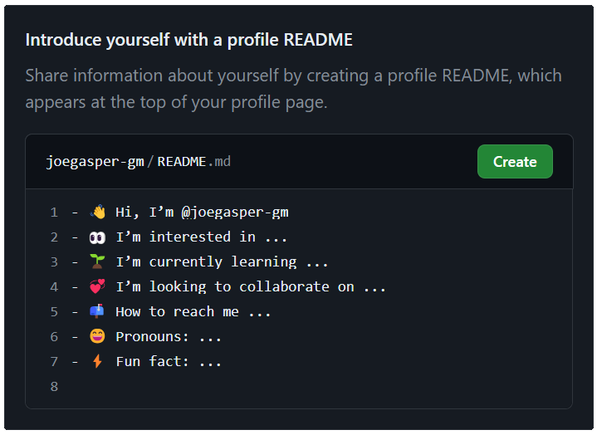
Development Tools: GitHub
Creating
a
Profile
README.md
Notes:
Create our first repo with the Profile template wizard.
Creates repo using your username.
The README.md is used on your “home page”.
Click the Create button.

Slide 15
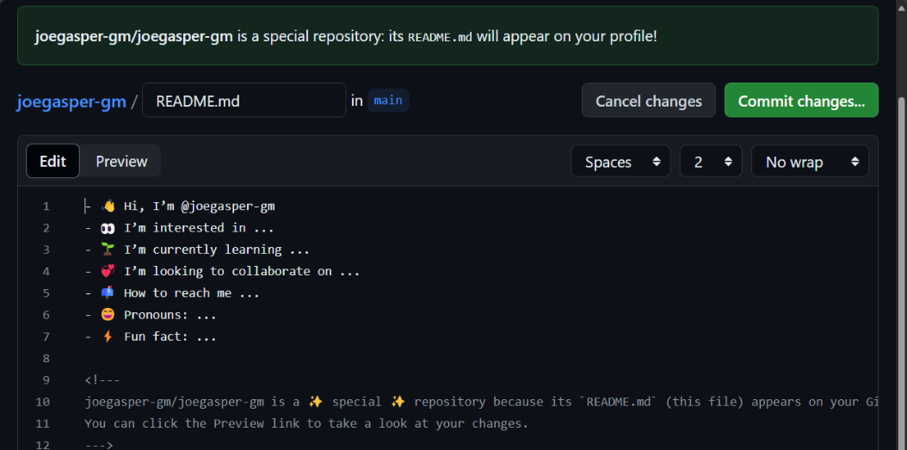
Development Tools: GitHub
Notes:
You could edit in the browser. But don’t just yet!
Click Commit changes… button
as we’re going to use VS Code!

Slide 16
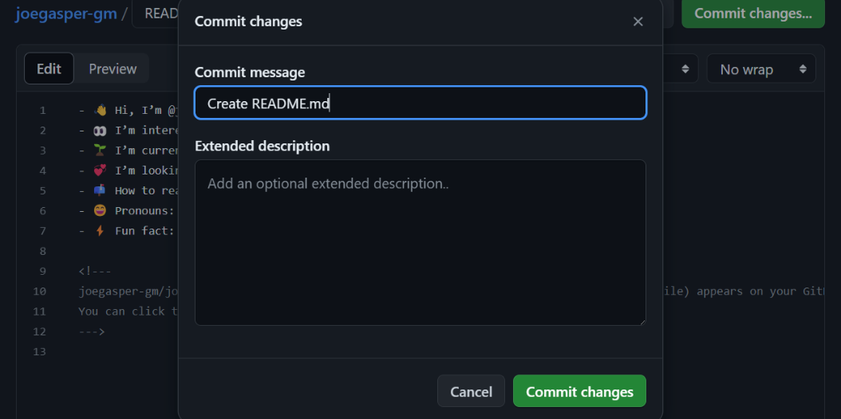
Development Tools: GitHub
Demo⌚
Notes:
Commit messages are important!
For you, for your collaborators.
Short, to the point.
Commit early, commit often!
It’s like commenting on Track Changes in Word.
OK STOP NOW GO DO

Slide 17
Development Tools: VS Code
In VS Code – Next Steps
Sync settings
Sign in to GitHub
Clone our profile repo
Set user.name and user.email
Edit, commit, sync, 🤯!
Integrating
GitHub
and
VS Code
Notes:
Let’s begin integrating GitHub and VS Code
VS Code knows you,
GitHub knows you,
But not Git – so set user.name and user.email

Slide 18
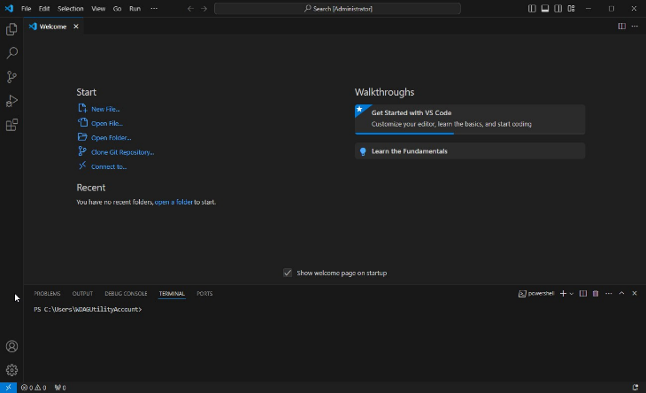
Development Tools: VS Code
Integrating
GitHub
and
VS Code
Notes:
Let’s begin integrating GitHub and VS Code

Slide 19
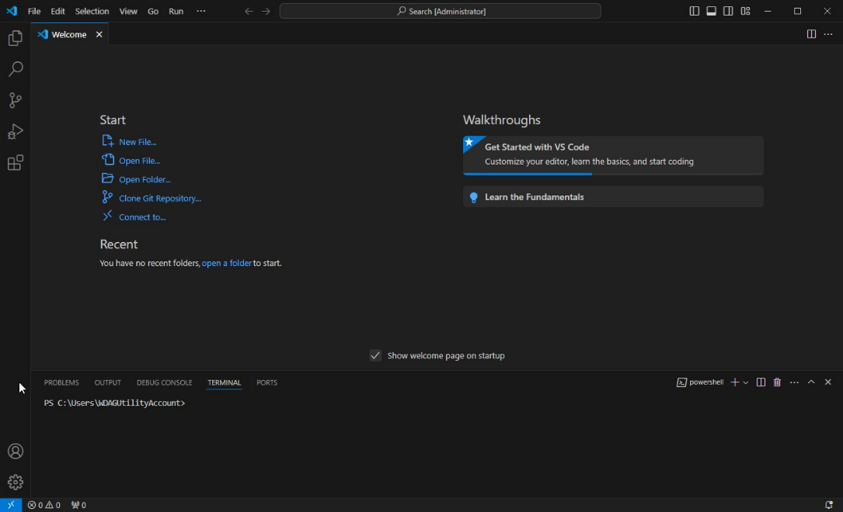
VS Code
Notes:
Let’s begin integrating GitHub and VS Code

Slide 20
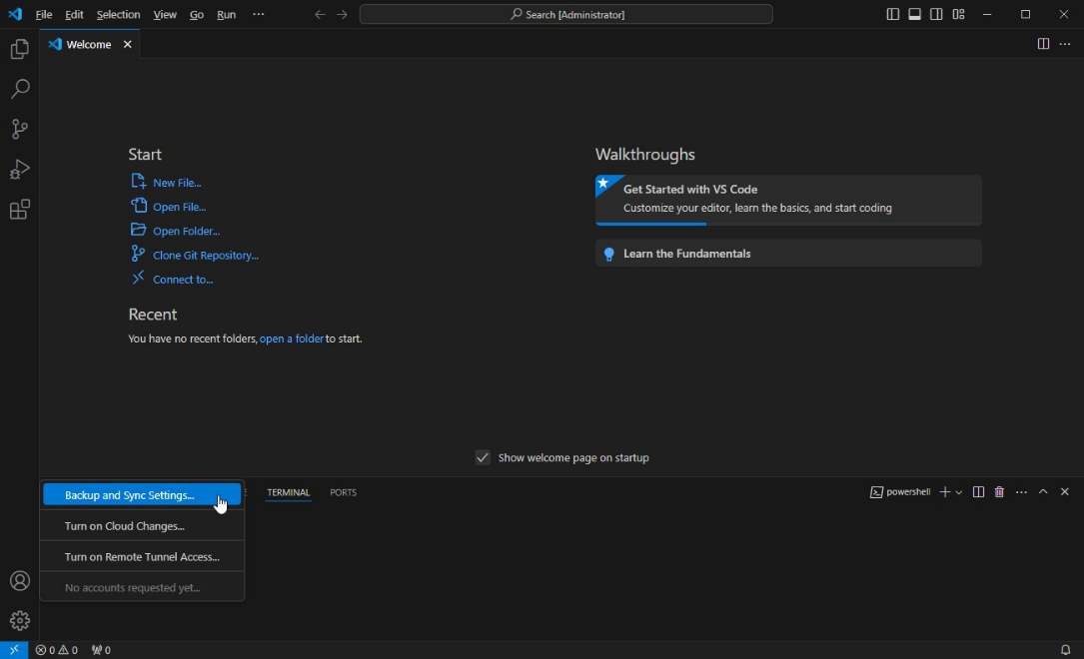
VS Code
Notes:
Backup and Sync Settings – great of using multiple computers or setting up a new one.

Slide 21
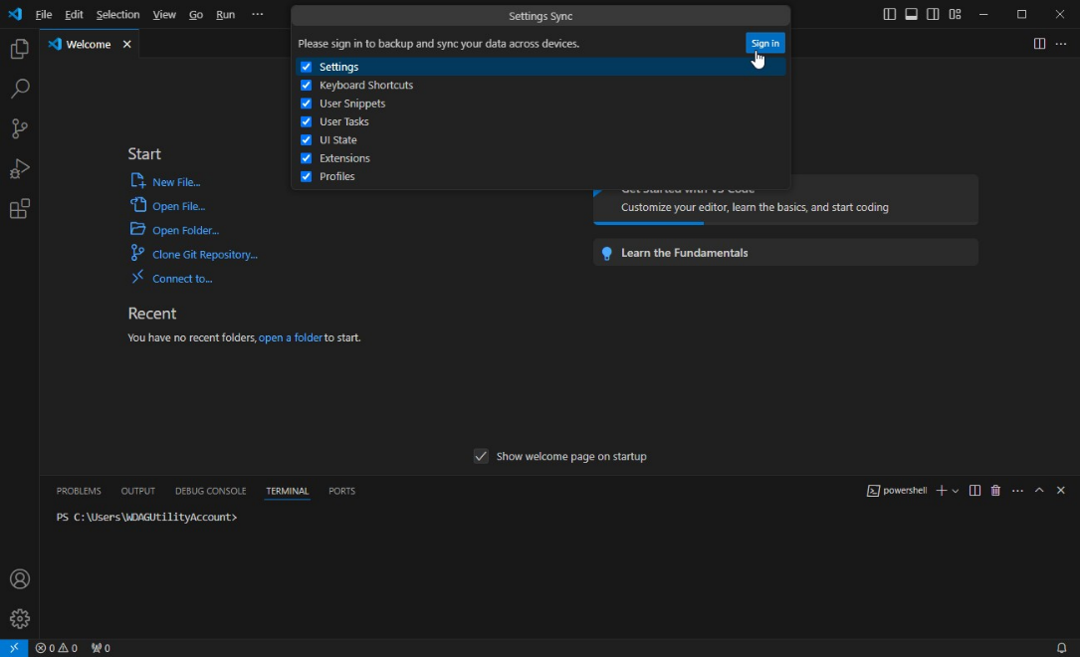
VS Code

Slide 22
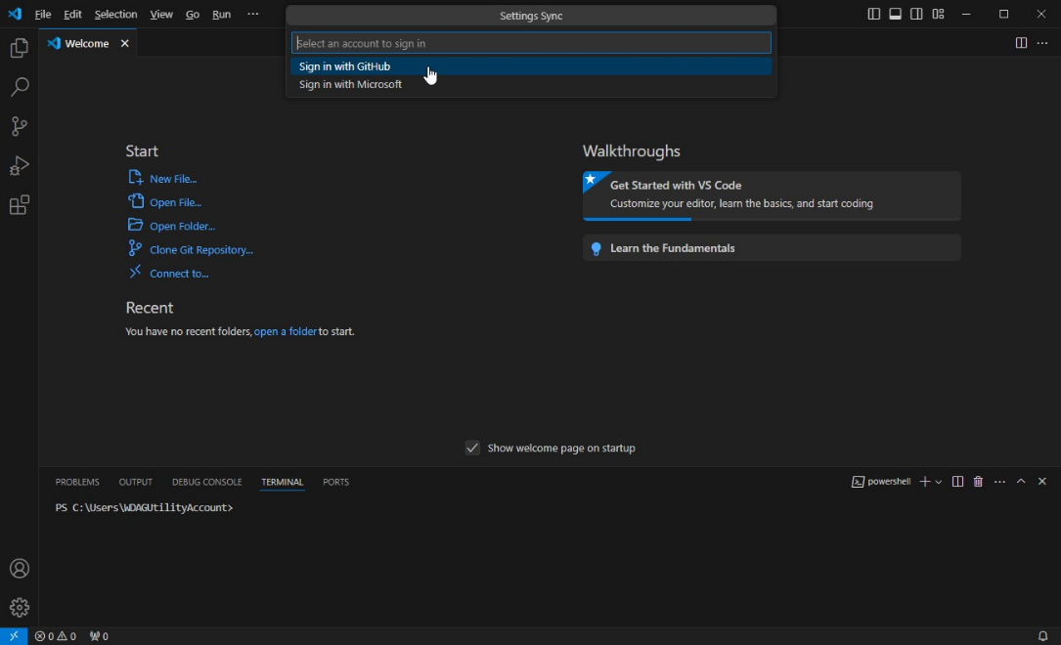
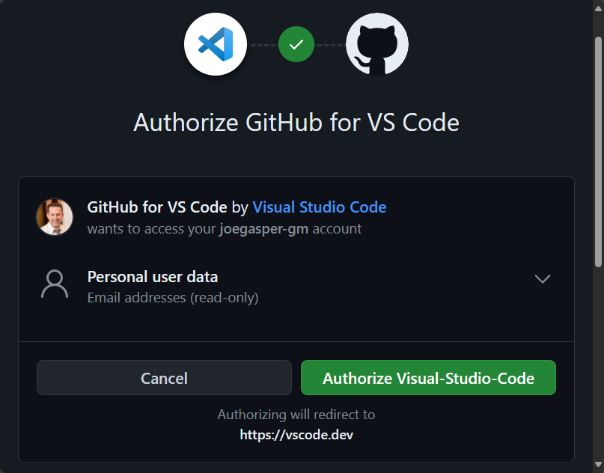
VS Code

Slide 23
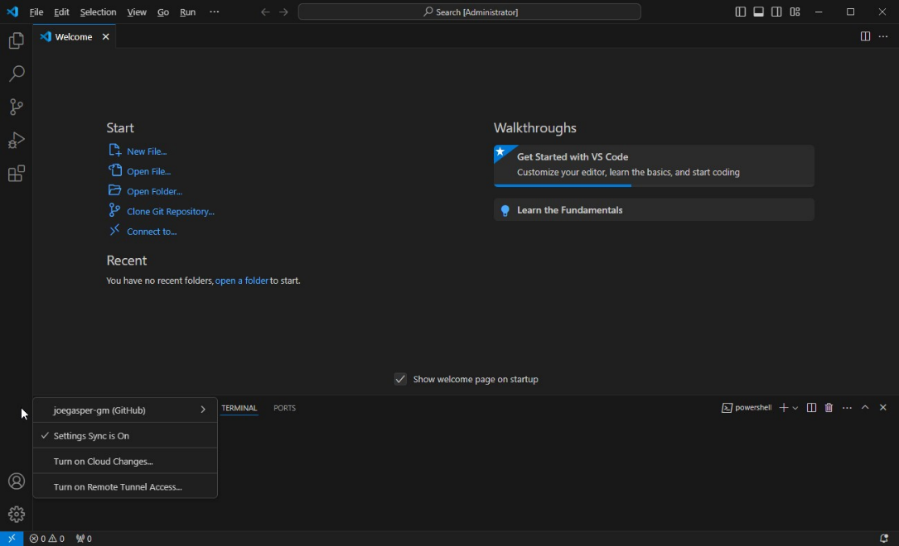
VS Code

Slide 24
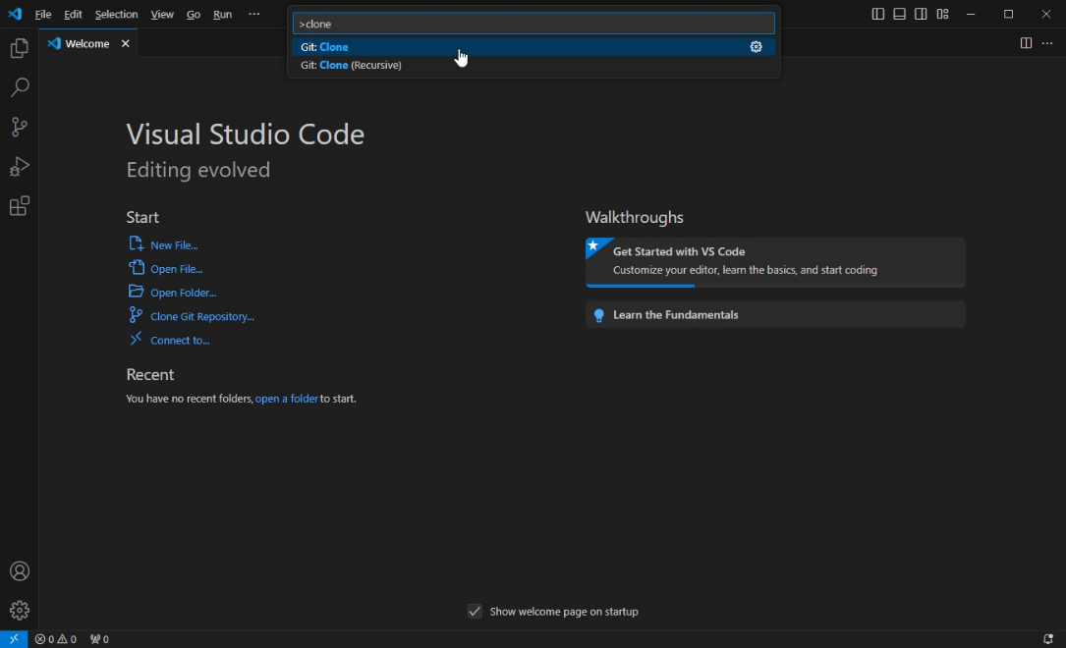
VS Code
Open the Command Palette…
Ctrl + Shift + P
Notes:
Ctrl + Shift + P
Command Palette…
Clone

Slide 25
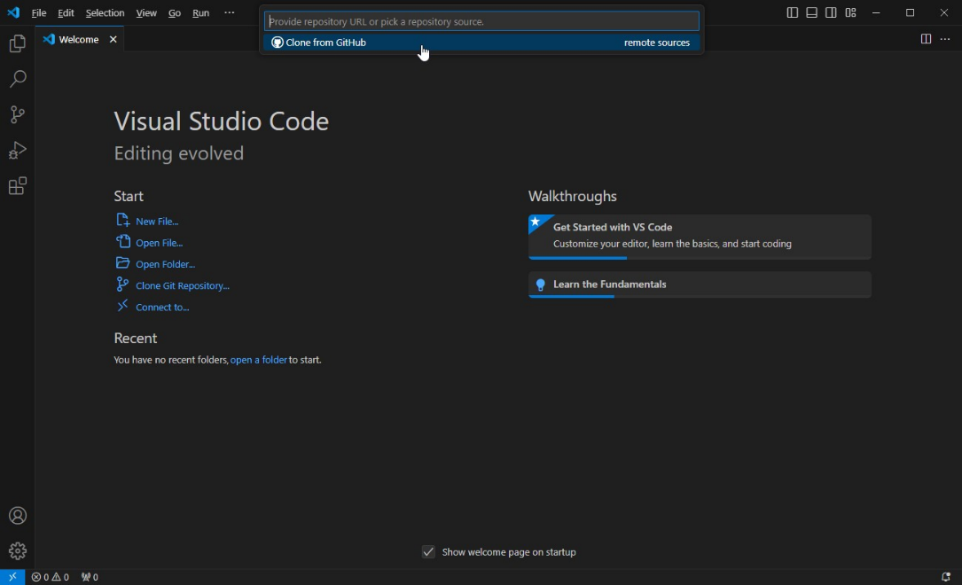
VS Code
Notes:
Easy integration with GitHub

Slide 26
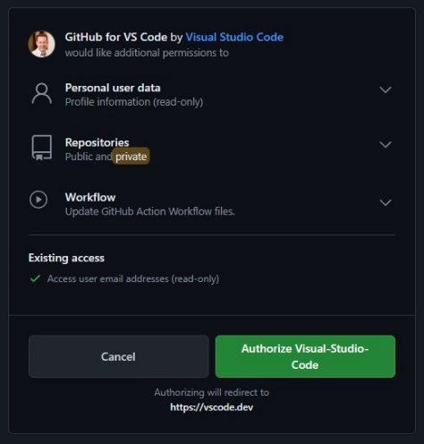
VS Code

Slide 27
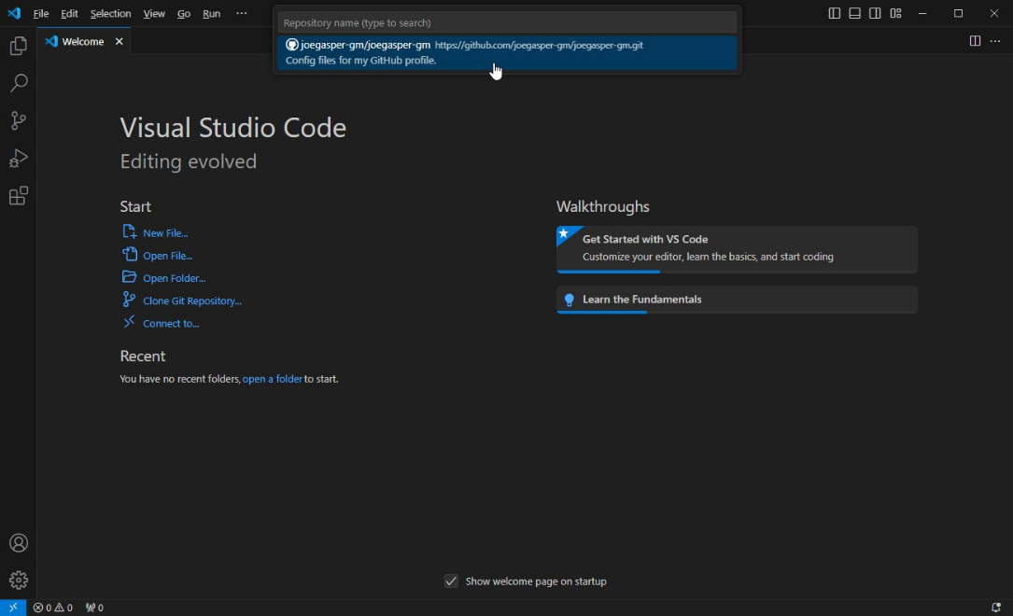
VS Code
Notes:
After auth you’ll see all your repos listed.

Slide 28
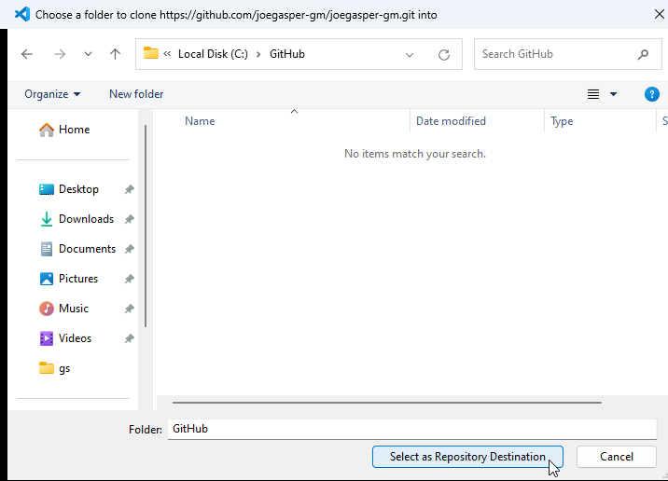
VS Code
Don’t place in cloud storage!
Notes:
Where to place the clone of the repo? NOT IN ONEDRIVE, DROPBOX, GDRIVE

Slide 29
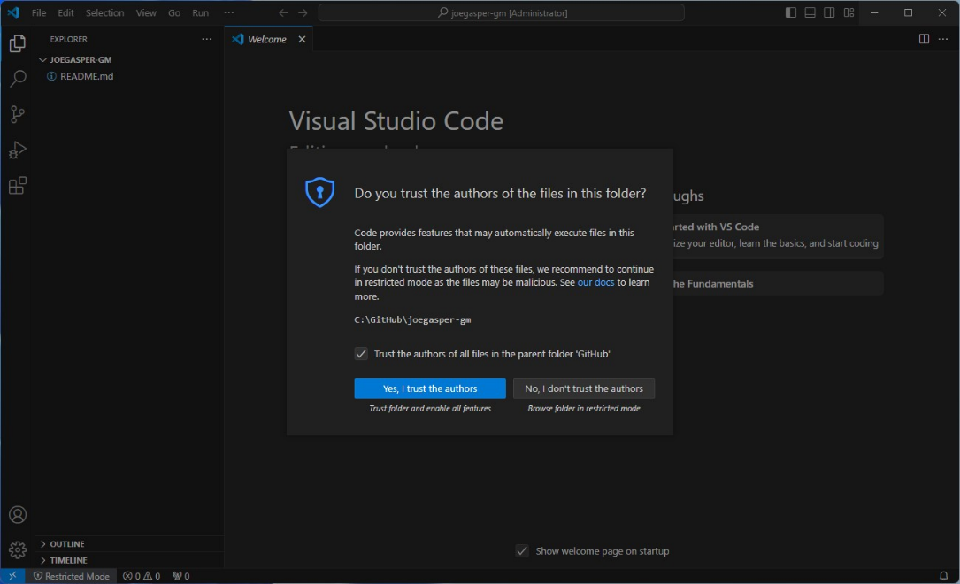
VS Code
Notes:
You do need to trust those you collaborate with.

Slide 30
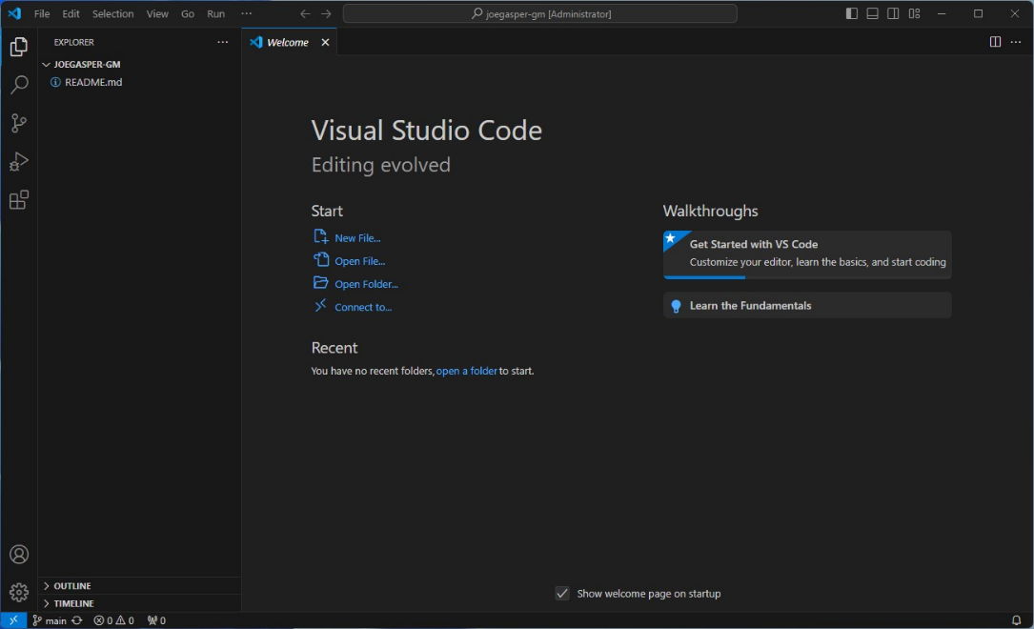
VS Code
Demo⌚
Notes:
OK STOP AND GO DO

Slide 31
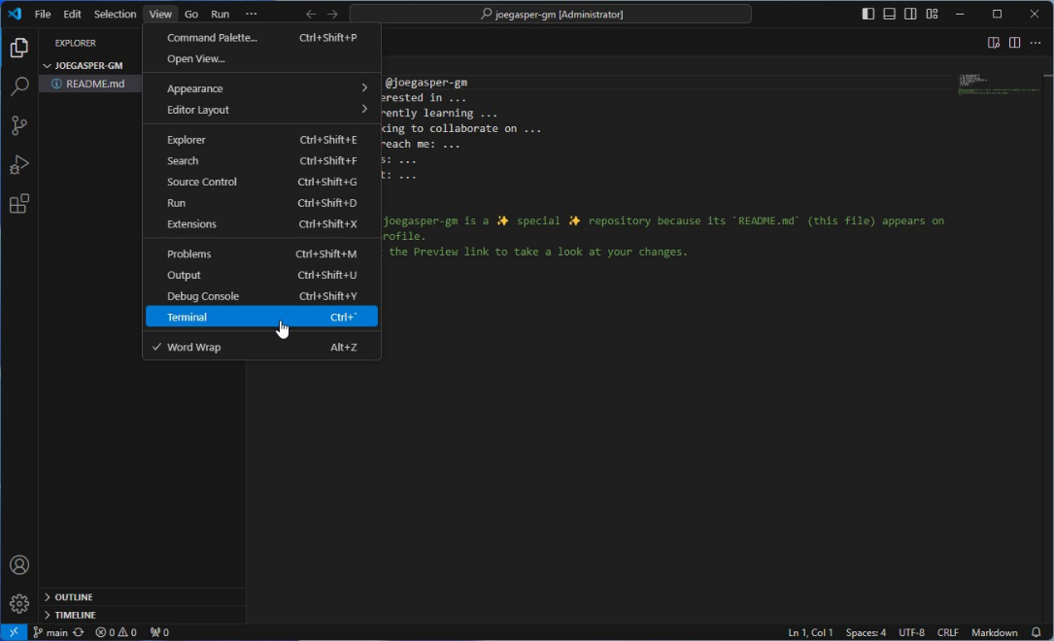
VS Code
Notes:
Open the built-in Terminal.

Slide 32
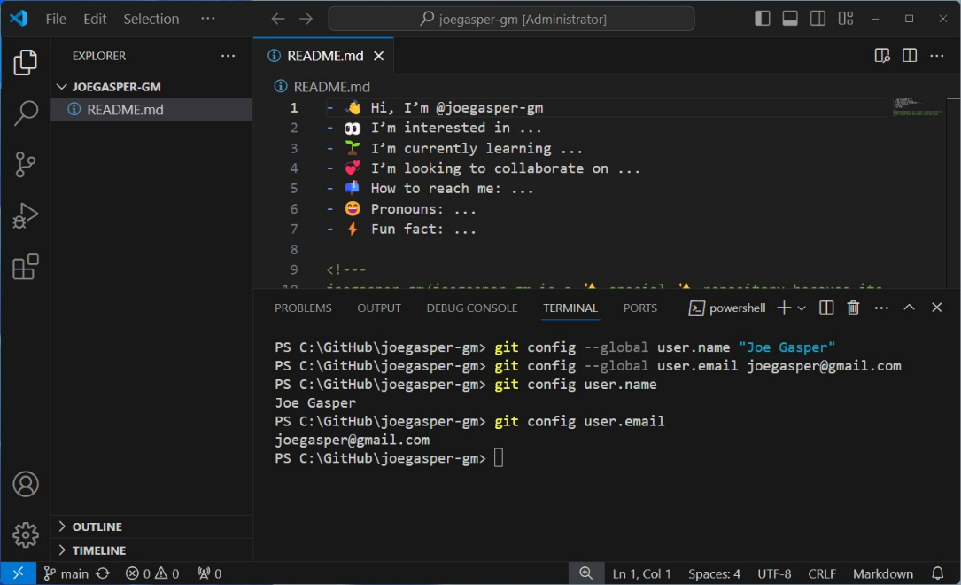
VS Code
Notes:
Config Git (or per repo without –global) to know who is doing what:
git config --global user.name "John Doe"
git config --global user.email johndoe@example.com
git config user.name
git config user.email

Slide 33
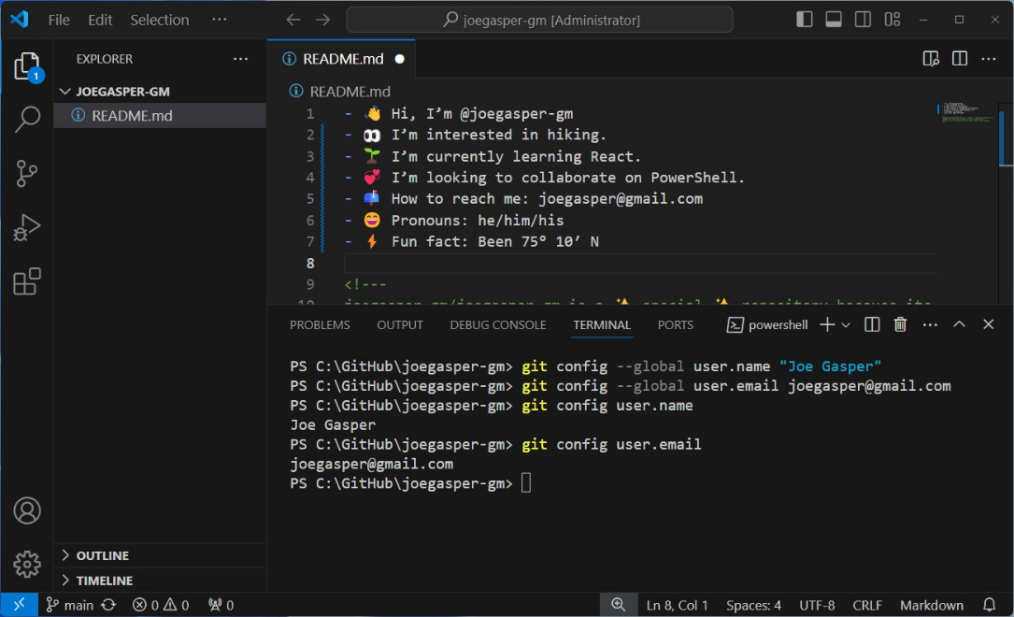
VS Code
Notes:
Edit the README.md file

Slide 34
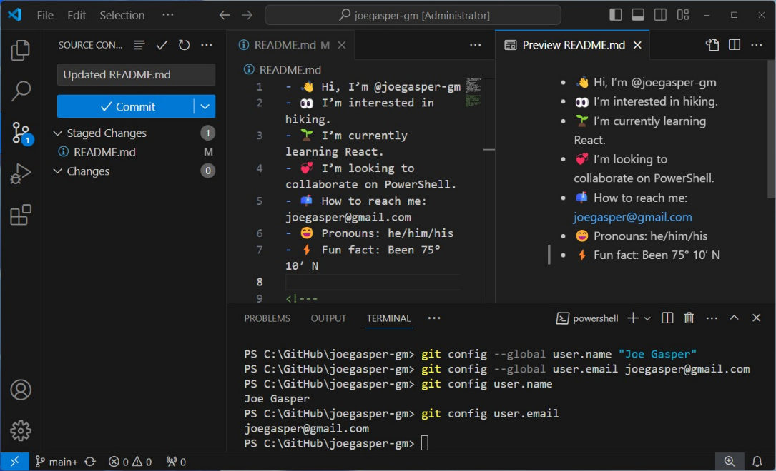
VS Code
Notes:
We can open the preview window.
Stage our change.
Staging is a step in the version control process where you prepare and organize your changes before committing them to the repository.
Think of it as a loading dock where you get everything ready for shipment (the commit).
Add commit comment – think about your collaborators.
Then Commit!
The is still only local changes…

Slide 35
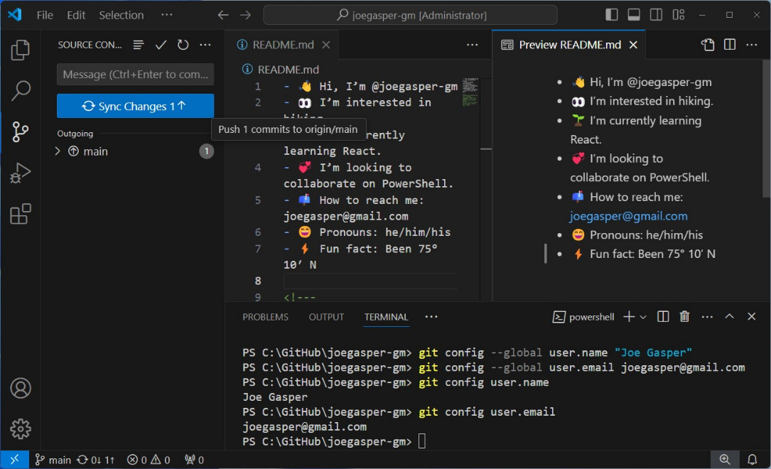
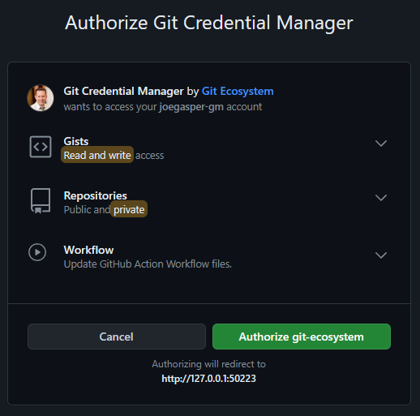
VS Code
Notes:
Sync Changes – might get prompt to authenticate/authorize one more time.

Slide 36
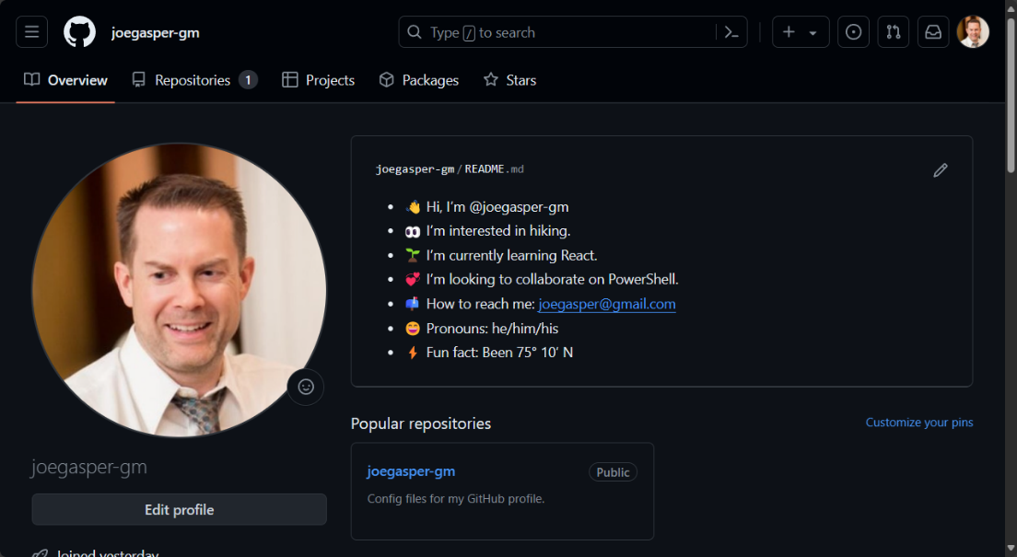
GitHub
Demo⌚
Notes:
Boom – You have a GitHub Profile
STOP, DEMO TIME

Slide 37
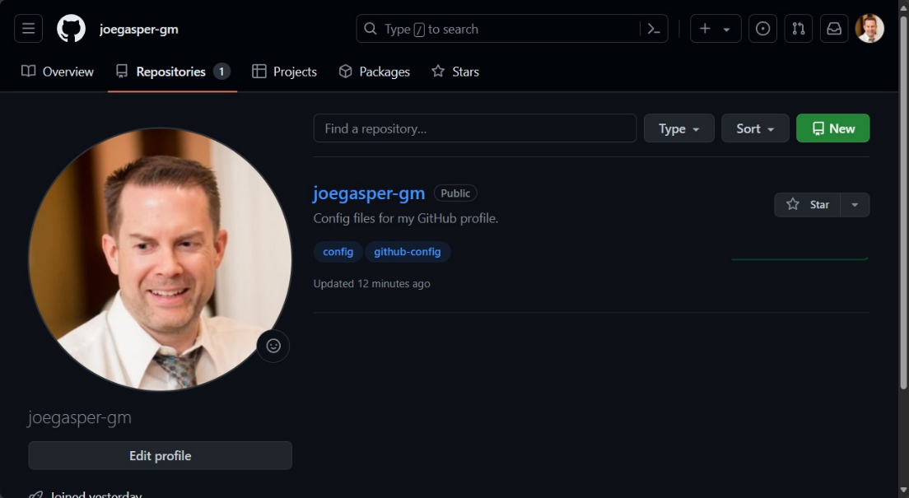
GitHub
Notes:
Make a new repo and bring in a collaborator.

Slide 38
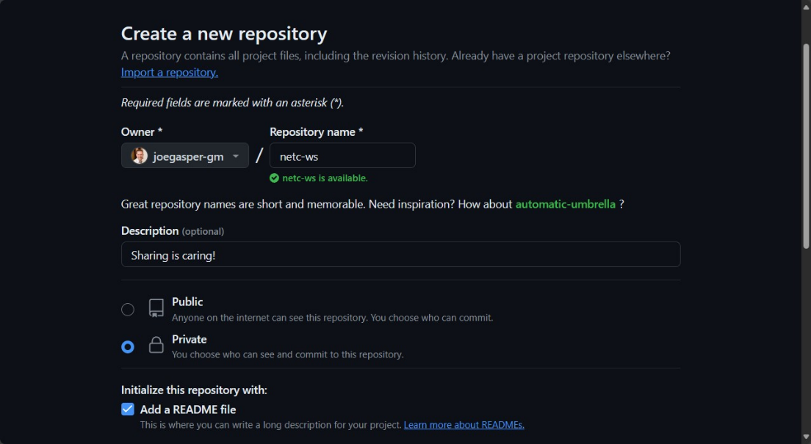
GitHub
Notes:
Make a new repo and bring in a collaborator.

Slide 39
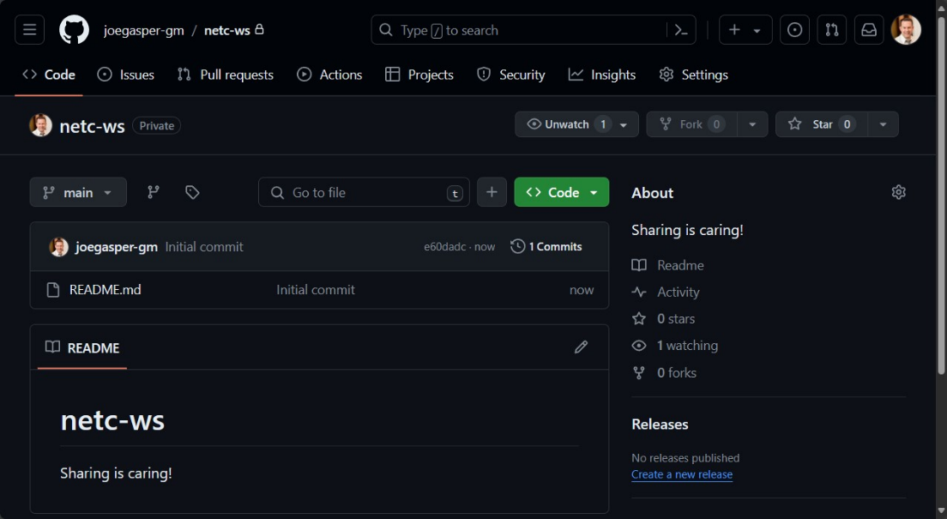
GitHub
Notes:
Make a new repo and bring in a collaborator.

Slide 40
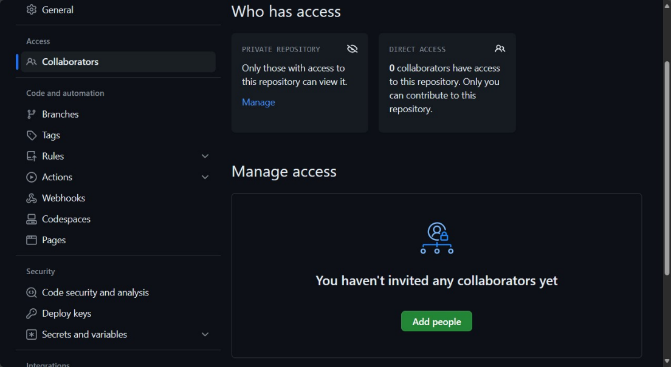
GitHub
Notes:
Make a new repo and bring in a collaborator.

Slide 41
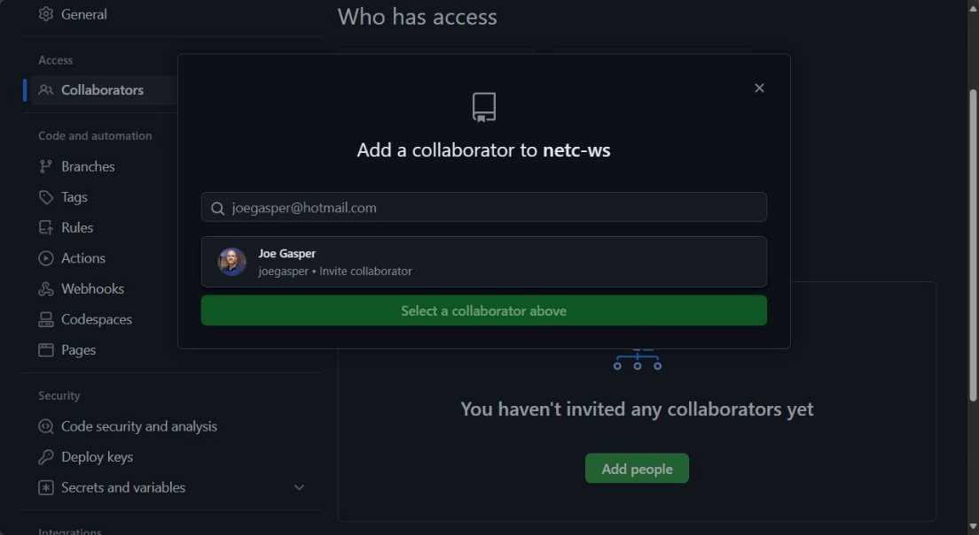
GitHub
Notes:
Make a new repo and bring in a collaborator.

Slide 42
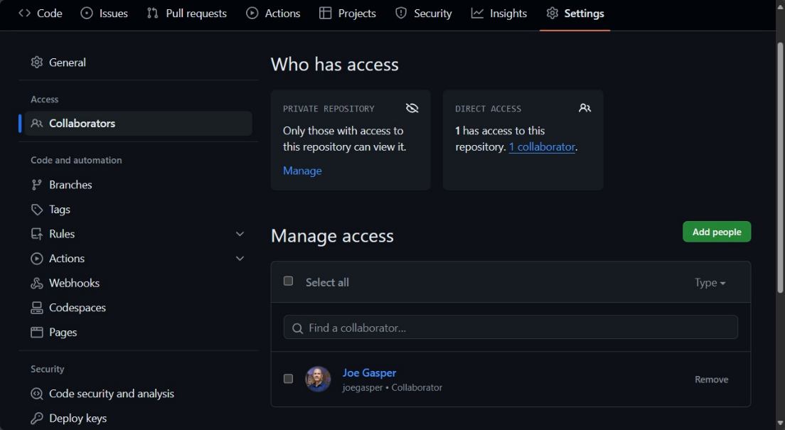
GitHub
Demo⌚
Notes:
Make a new repo and bring in a collaborator.
OK STOP AND GO DO – GET SOMEONE TO GIVE ACCESS TO THIS NEW REPO

Slide 43
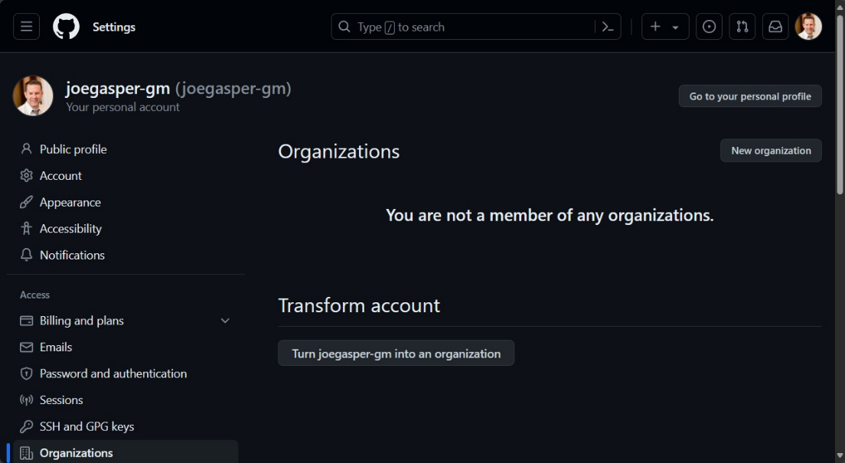
GitHub
Notes:
Make an Org and Team

Slide 44
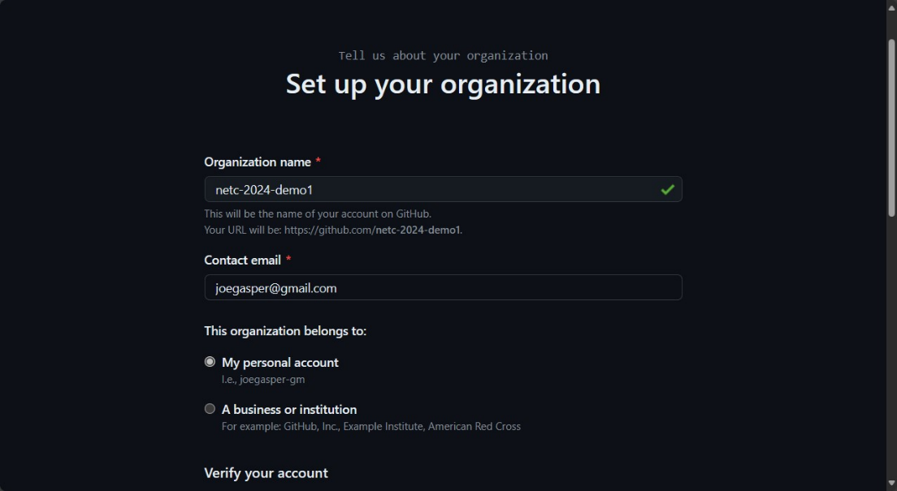
GitHub
Notes:
Make an Org and Team

Slide 45
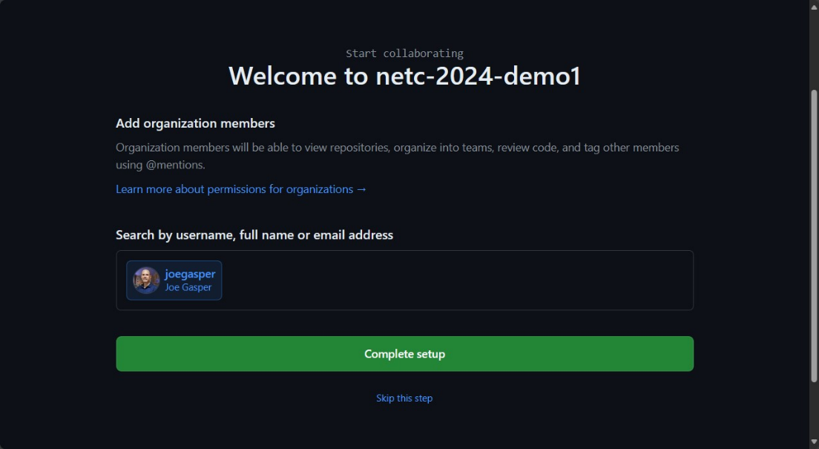
GitHub
Notes:
Make an Org and Team

Slide 46
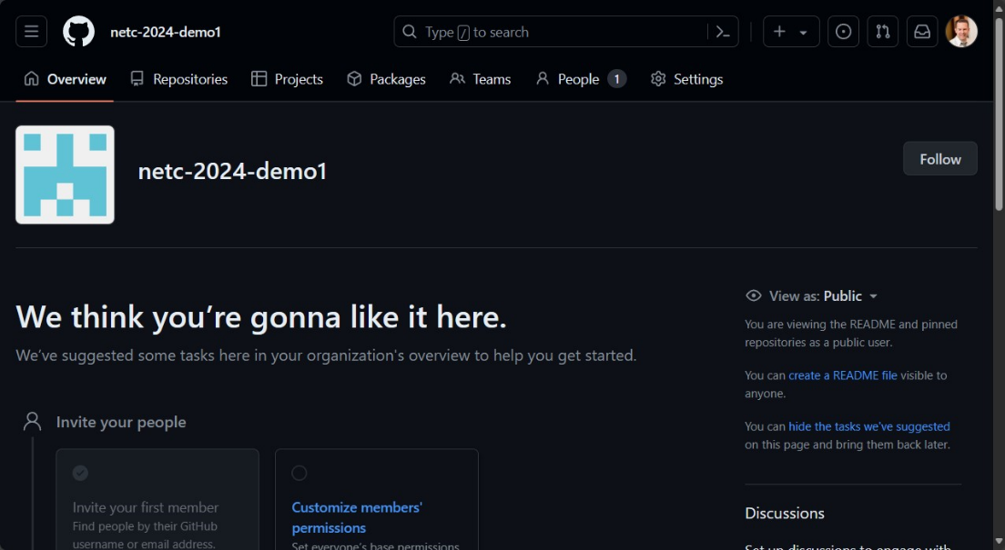
GitHub
Notes:
Make an Org and Team

Slide 47
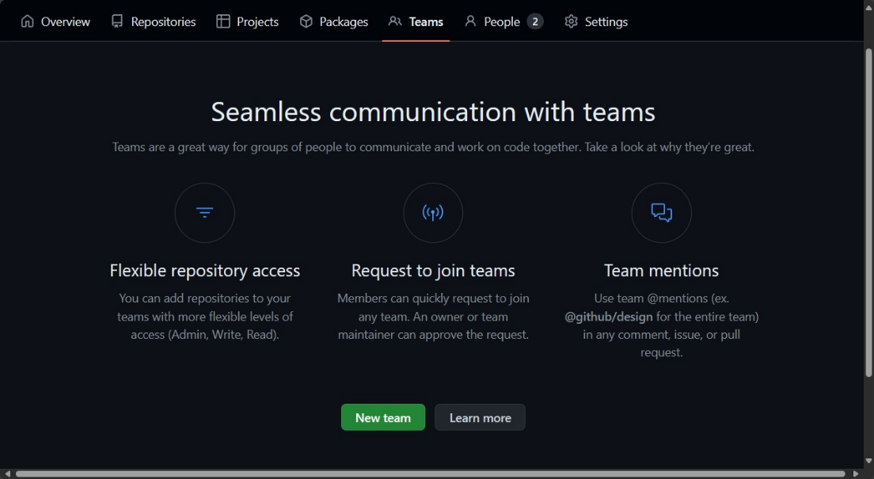
GitHub
Notes:
Create Team in the Org

Slide 48
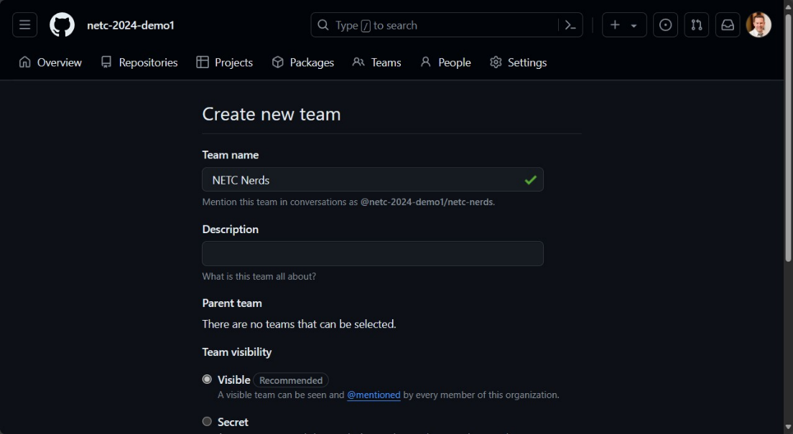
GitHub
Notes:
Make an Org and Team

Slide 49
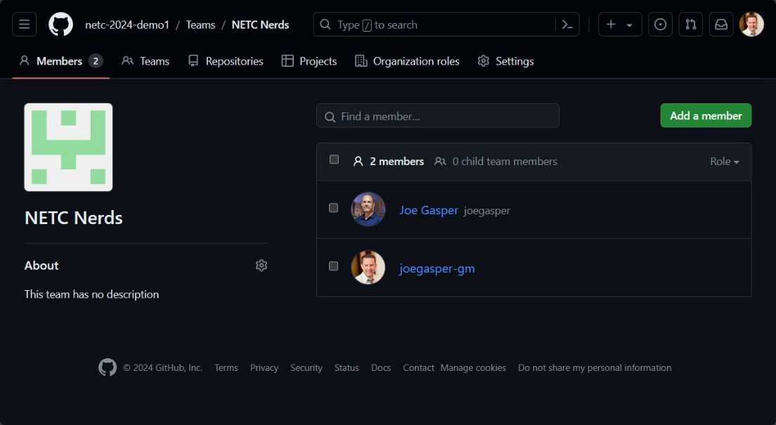
GitHub
Demo⌚
Notes:
Add a member to the Team
OK STOP NOW GO DO

Slide 50
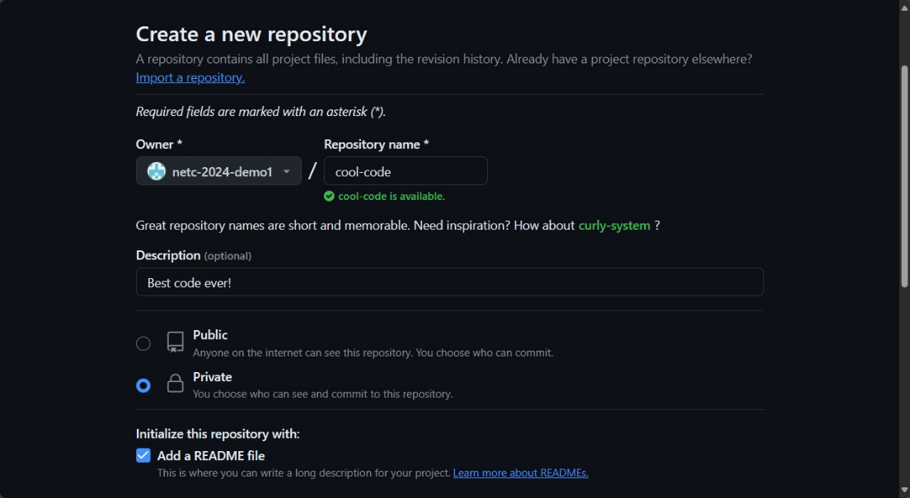
GitHub
Notes:
Create repo in org an add team access

Slide 51
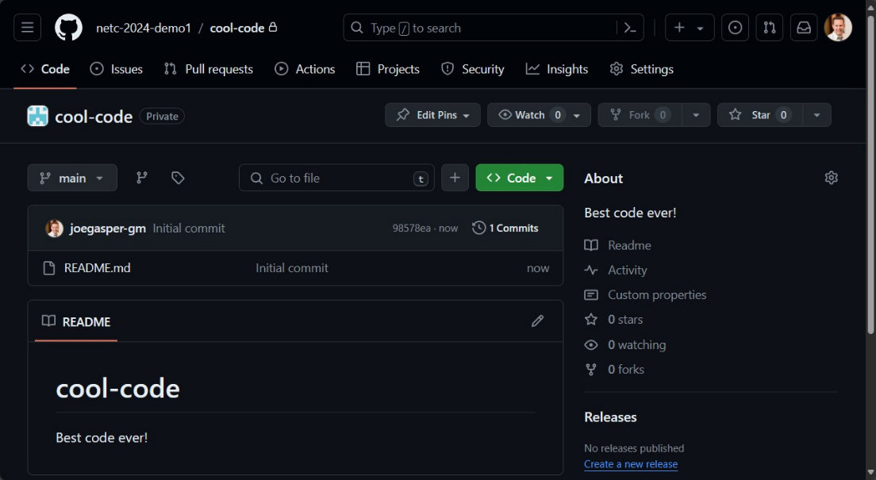
GitHub
Notes:
Create repo in org an add team access

Slide 52
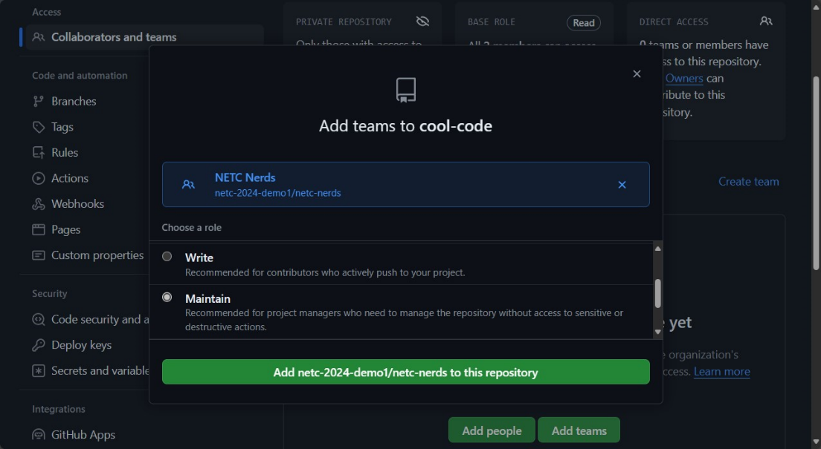
GitHub
Notes:
Set the role of the Team on the repo

Slide 53
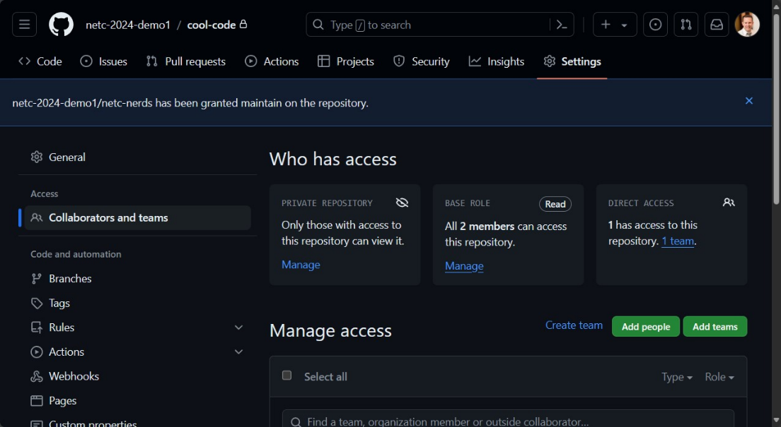
GitHub
Demo⌚
Notes:
Create repo in org an add team access
OK STOP NOW GO DO

Slide 54
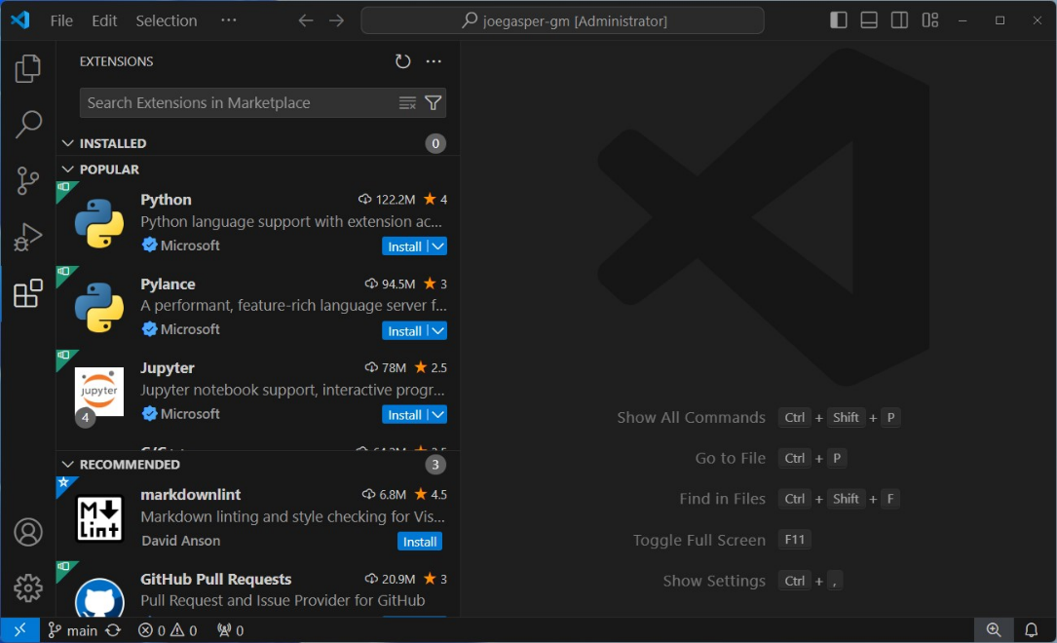
VS Code
PowerShell
Python
GitHub Copilot
Azure * (all the services)
Code Spell Checker
Docker
GistPad
indent-rainbow
Live Share
markdownlint
Rainbow CSV
vscode-icons
XML
YAML
Arduino for VS Code

Slide 55
Resources
Git
Git Guides - install git (github.com)
Git cheatsheet - GitHub Docs
GitHub
Get started with GitHub documentation - GitHub Docs
skills/github: Get started using GitHub in less than an hour.
Setting your username in Git - GitHub Docs
Setting your commit email address - GitHub Docs
Creating gists - GitHub Docs
GitHub for SysAdmins with April Edwards – RunAsRadio
GitHub Education – GitHub Copilot!
GitHub Copilot getting started (visualstudio.com)
Quickstart for GitHub Copilot - GitHub Docs
VS Code
Foreword · Visual Studio Code - The Essentials (microsoft.github.io)
Visual Studio Code – YouTube
Visual Studio Code Extensions
Markdown
Markdown Cheat Sheet | Markdown Guide
Quickstart for writing on GitHub - GitHub Docs

Slide 56
Git Going: Launching Your Code Journey with GitHub & Visual Studio Code
Joe Gasper
Systems Administrator
University of Florida
Institute of Food and Agricultural Sciences
gasperj@ufl.edu
in/joegasper
@joegasper & @gasperj

Slide 57
Git Going! Thank you!
Joe Gasper
Systems Administrator
University of Florida
Institute of Food and Agricultural Sciences
gasperj@ufl.edu
in/joegasper
@joegasper & @gasperj

